Slide 1
PROJECT DESIGN PROCESS - 1

Slide 2
TEAM DETAILS :
TEAM ID | PNT2022TMID32200
PROJECT NAME | REALTIME COMMUNICATION POWERED BY AI FOR SPECIALLY ABLED PERSON

Slide 3
SOLUTION REQUIREMENT :
The project aims to develop a system that converts the sign language into a human hearing voice in the desired language to convey a message to normal people, as well as convert speech into understandable sign language for the deaf and dumb.

Slide 4
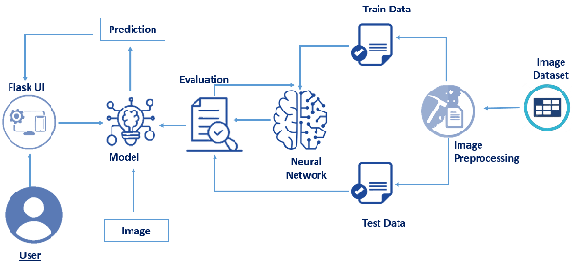
TECHNICAL ARCHITECTURE :
MODEL – 1:

Slide 5
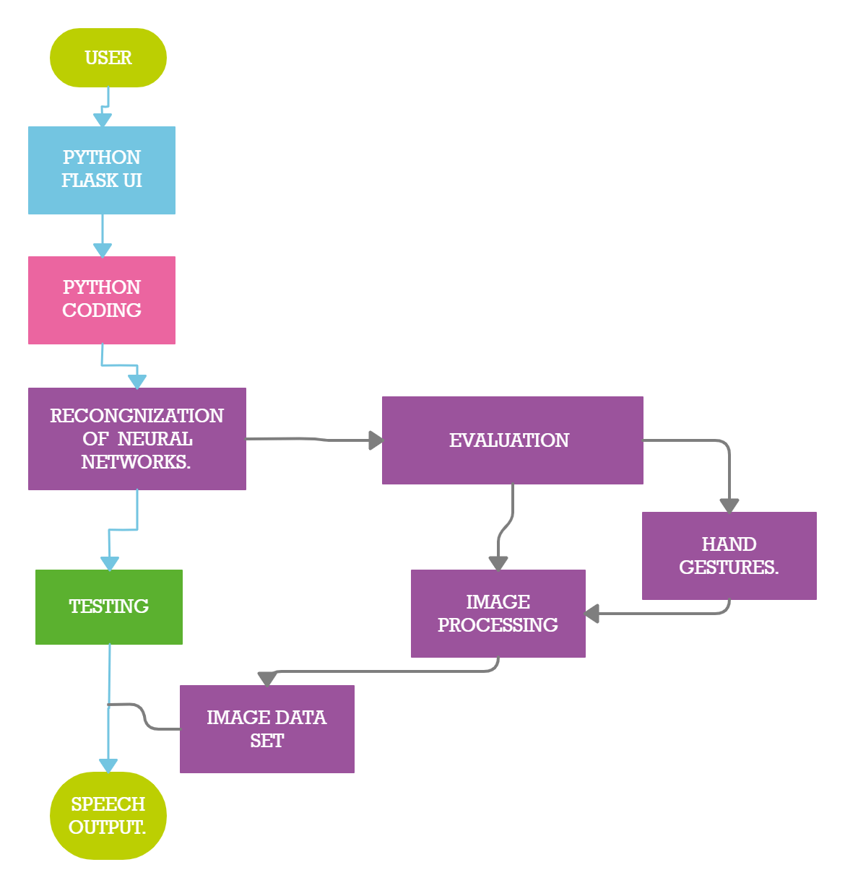

Slide 6
THANK YOU …

